Slide 1
STRING FUNCTION
-muthu jeya k

Slide 2
Strings in Java
Advertisement
Advertisement
Advertisement
String is a sequence of characters. But in Java, string is an object that represents a sequence of characters. The java.lang.String class is used to create a string object.
The Java String is immutable which means it cannot be changed. Whenever we change any string, a new instance is created.
For mutable strings, you can use StringBuffer and StringBuilder classes.
Forexample:char[] ch={‘k‘,’a’,’v’,’i,’y’,’a’};
String s=new String(ch); is same as: String s=“kaviya";
Java String class provides a lot of methods to perform operations on strings such as compare(), concat(), equals(), split(), length(), replace(), compareTo(), intern(), substring() etc.
The java.lang.String class implements Serializable, Comparable and CharSequence interfaces

Slide 3
create a string object
There are two ways to create String object:
By string literal
By new keyword
Java uses the concept of String literal to make Java more memory efficient
String Literal
Java String literal is created by using double quotes.
To make Java more memory efficient (because no new objects are created if it exists already in the string constant pool).
For Example: String name = “kaviya”;
New keyword
String s = new String(“kaviya”);
In such a case, JVM will create a new string object in normal (non-pool) heap memory and the literal “Welcome” will be placed in the string constant pool. The variable s will refer to the object in the heap (non-pool)
For Example: String A=new String(“Kaviya”);

Slide 4
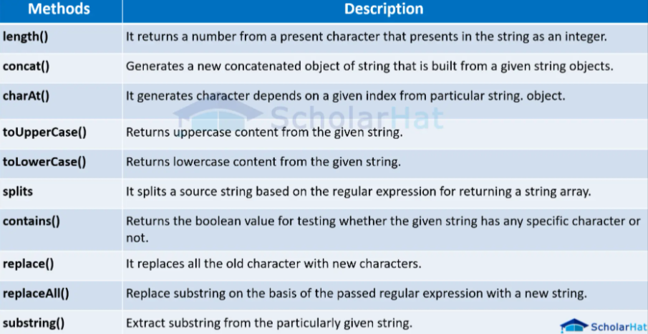
Java String class methods

Slide 5
